Slide 1
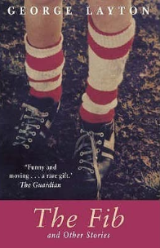
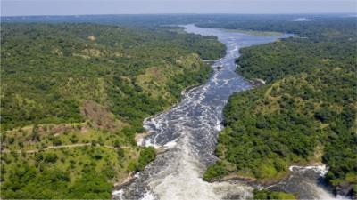
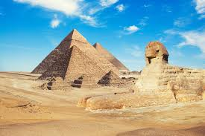
Razorbills Autumn 2020
Maths
Place value – numbers up to 10 million including numbers with 3 decimal places
The 4 Operations - Addition, subtraction, multiplication and division.
Measurement – Converting Units
Measurement – Perimeter and area
Fractions
English
We will be reading Danny the Champion of the World by Roald Dahl. Through this book we will explore Modern Classical fiction.
Autobiographies using extracts from The Fib by George Layton and Boy by Roald Dahl.
Explanations – We will study how explanations are written and we will write our own explanations using inspiration from other subjects.
Poetry
Science 1
Animals including Humans
We will find out about:
The circulatory system – the heart, blood vessels and blood.
Recognise the impact of diet, exercise, drugs and lifestyle on the way our bodies function.
How nutrients are transported through our body.
Music
Where did the ukulele originate?
Parts of the ukulele
Chords
Learning songs for a virtual performance
Spanish
Numbers to 40
What time is it?
RE
Why is the Torah so important to Jewish people?
For Christians, what kind of king was Jesus?
P.E
Netball
Football
Hockey
Tag Rugby
Computing
Getting to know Google Classrooms – Collecting and communicating
Typing Club
PSHE
Health and Well-being
Science 2
Research, investigate,
experiment, analyse results and present findings.
Light
We will find out about:
What are light sources?
How do we see things?
How does light travel?
How can we use mirrors to see round corners?
Can we bend light – if so, what happens?
Investigating colour.
Investigating shadows.
History
Ancient Egypt
When did the Ancient Egyptians rule?
What can we tell about Ancient Egypt from objects that have survived?
What was life like in Ancient Egypt?
What did the Ancient Egyptians believe about gods and life after death?
DT
Food
Research foods available to both ancient Egyptians and modern Egyptians
Try some foods and give opinions
Research healthy recipes
Design and create a dish for an Egyptian banquet
Evaluate your work
Art
Digital Media Egyptian Portraits
Investigate Egyptian artwork.
Hieroglyphics
Explore patterns used in Egyptian art.
Use digital media and sketch book work to create a collage in the style of Egyptian art.
Geography
Rivers
The water cycle
Rivers around the world
The stages and features of a river
Human impact on rivers
How does flooding affect communities?

