Slide 1
You’re the Boss!
It’s up to you. Now it’s your turn to tell me what you think.

Slide 2
What are these slides all about?
This is a really important group of slides because it’s all about you; what you’ve enjoyed about PSHE, what you’ve learnt and what you’d like to know more about.

Slide 3
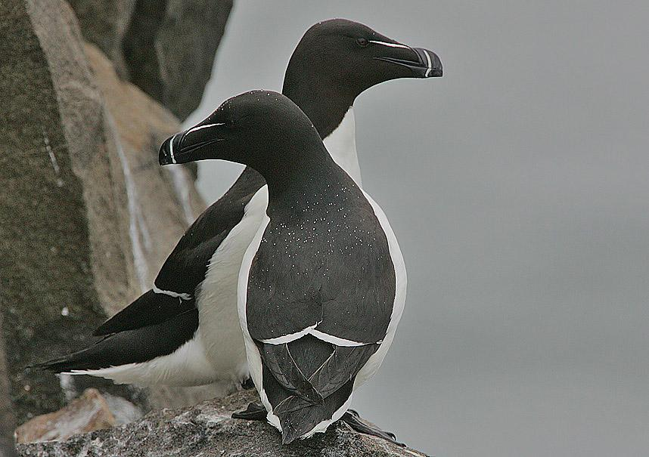
So why does this matter?
This matters, it’s important because you matter and you’re important.
Razorbills, each one of you and your learning needs are important. This is your life!

Slide 4
Answer the following question honestly
What have you gained, learnt or enjoyed about this year’s PSHE lessons, both at school and home learning? Don’t check out the next slide until you’ve done this by yourself!
Mind map this. There are no or wrong answers x
PSHE and ME

Slide 5
Below are a list of some of the topics that we have covered in PSHe this year. I have also included some that we will be covering later:
Laws Human rights The rights of the child
Stereotypes Friendships and positive relationships British Values
Democracy Belonging to a community Respecting ourselves and others
Well being and mental Health Behaviour and how it affects others
Diversity and valuing difference Money and taking care of the environment
Feelings and emotions Puberty, physical and emotional changes
Online safety Achievements and aspirations Change and transitions
Anything else

Slide 6
Now choose from the topics and mind map which topic you have enjoyed the most or have gained the most from.
PSHE and ME

Slide 7
Now tell me how you prefer learning. You can choose as many options as you like but try to put them in order so that I can see what your favorites are. Choose from the list below:
Small group work (like writing or chatting to people on your table), Class discussions, watching a power -point or slides, whole class discussions, being a bit more creative such as making something or challenge activities, expressing thoughts through individual art or writing.

Slide 8
Are there any other ways that you like learning that we could use in PSHE?
Finally, is there anything that I could do better? I’d like to make these lessons as valuable and enjoyable as possible, so now is your chance to let me know.
Can’t wait to hear back from you all! Only a little bit nervous!
Have fun lovely razorbills x

