Slide 1
The Goldfish Boy
Lisa Thompson
Chapter 25 – Mr Rory Jenkins

Slide 2
Before you read this chapter think about these things…
What are your thoughts on Mr Jenkins from what you know of the story so far?
Do you think Mr Jenkins has anything to do with the disappearance of Teddy?
Either read this on your own, get someone to read it to you or read it with an adult. You choose.

Slide 3
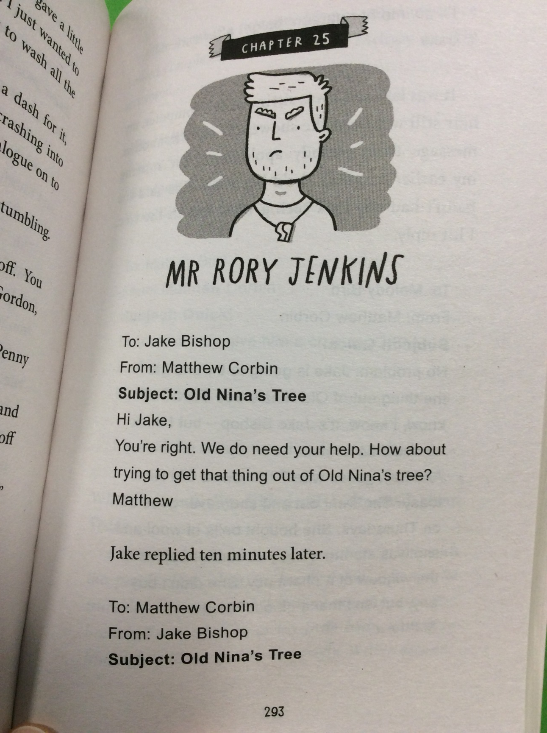

Slide 4
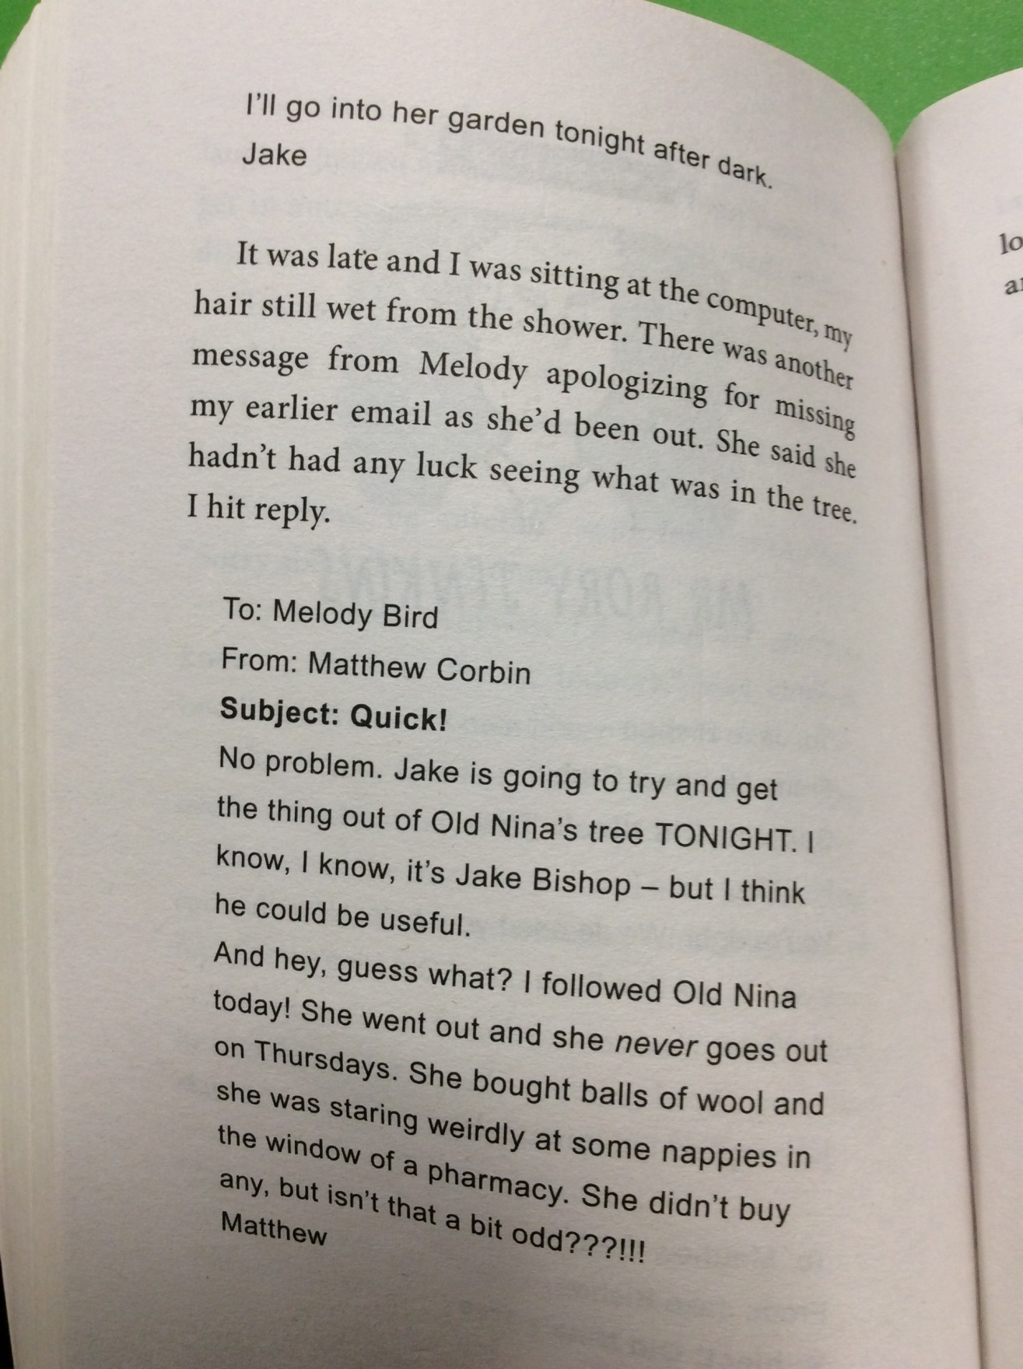

Slide 5
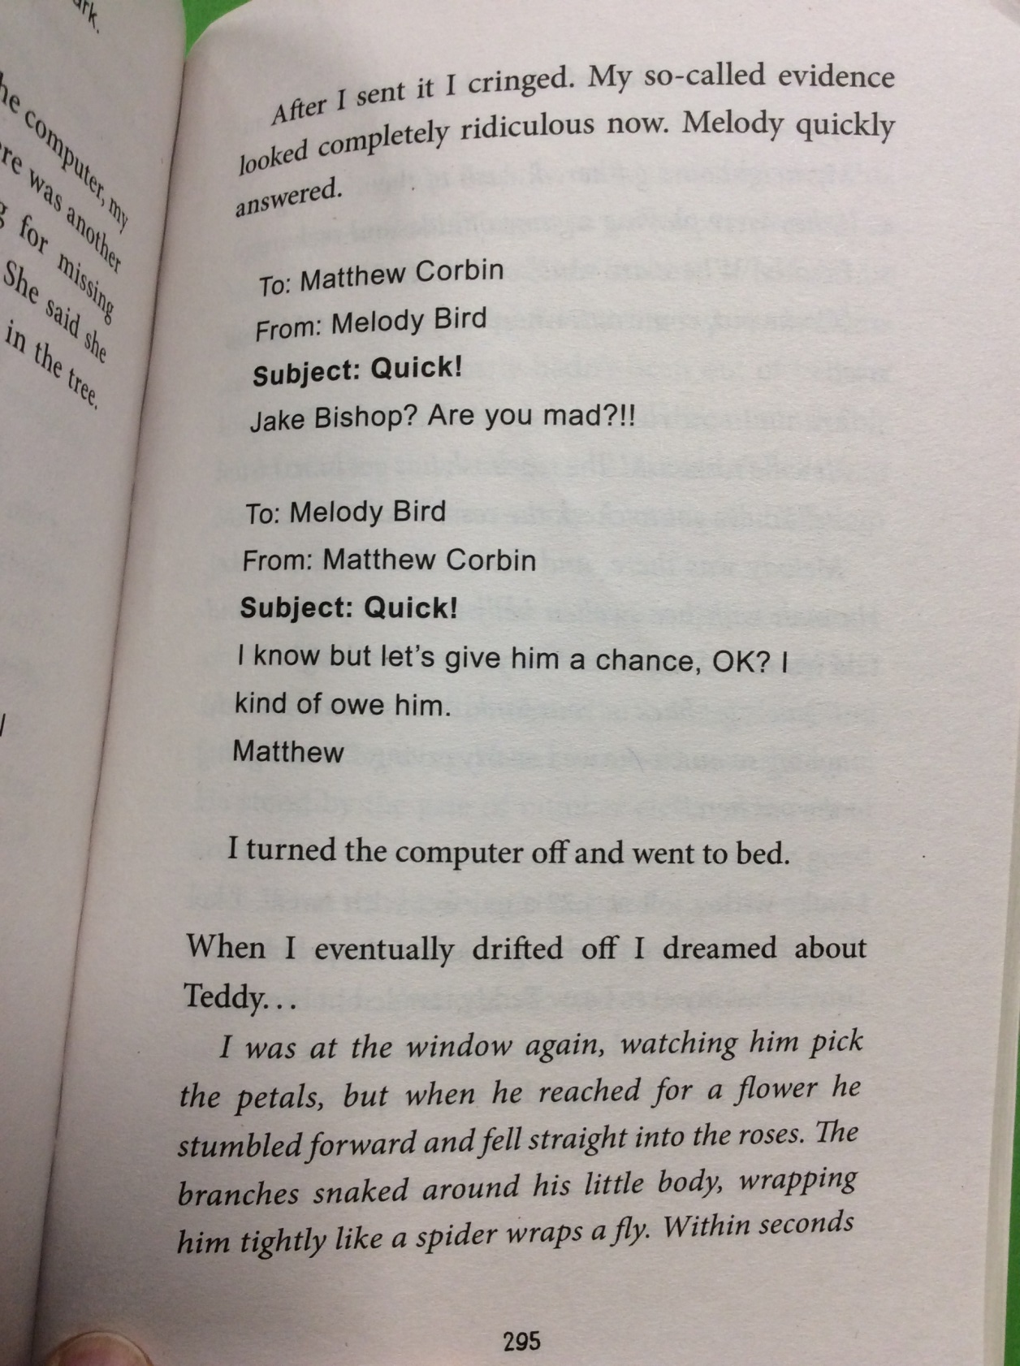

Slide 6
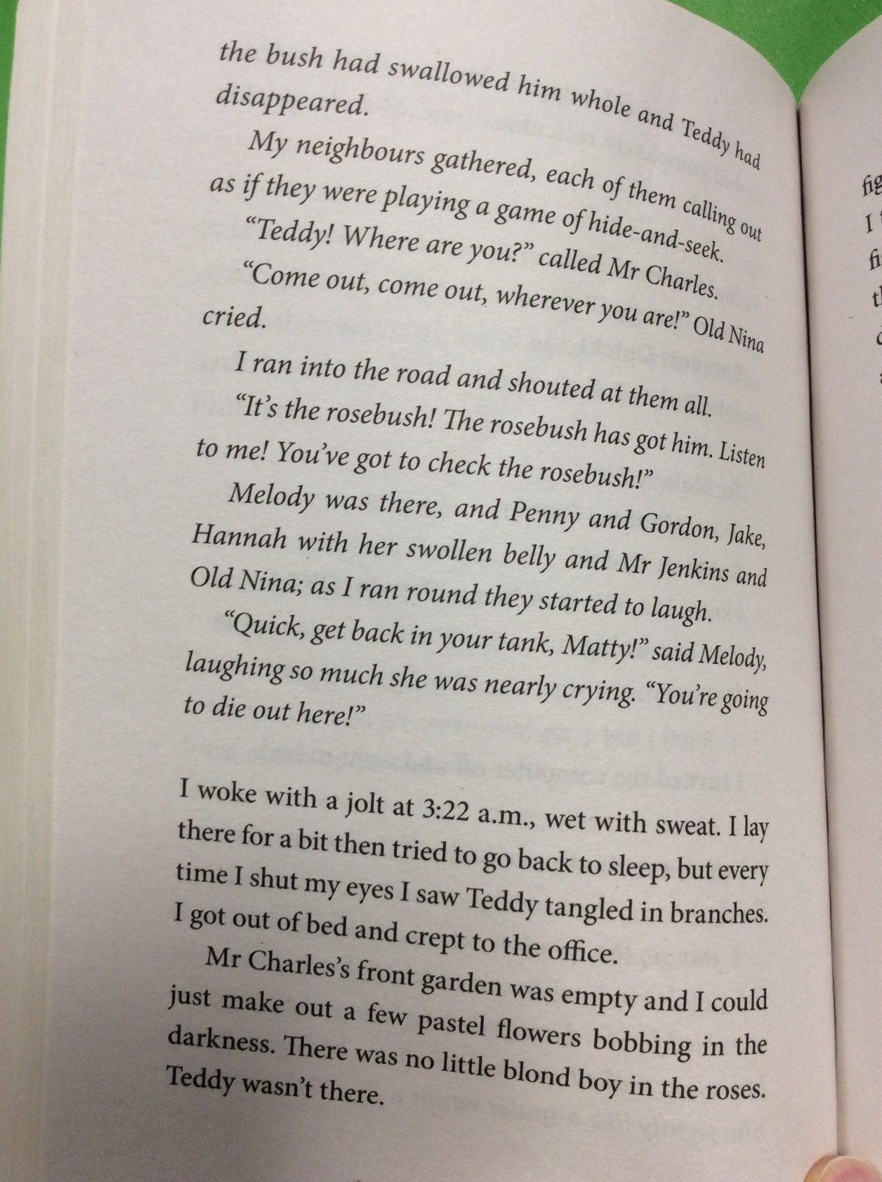

Slide 7
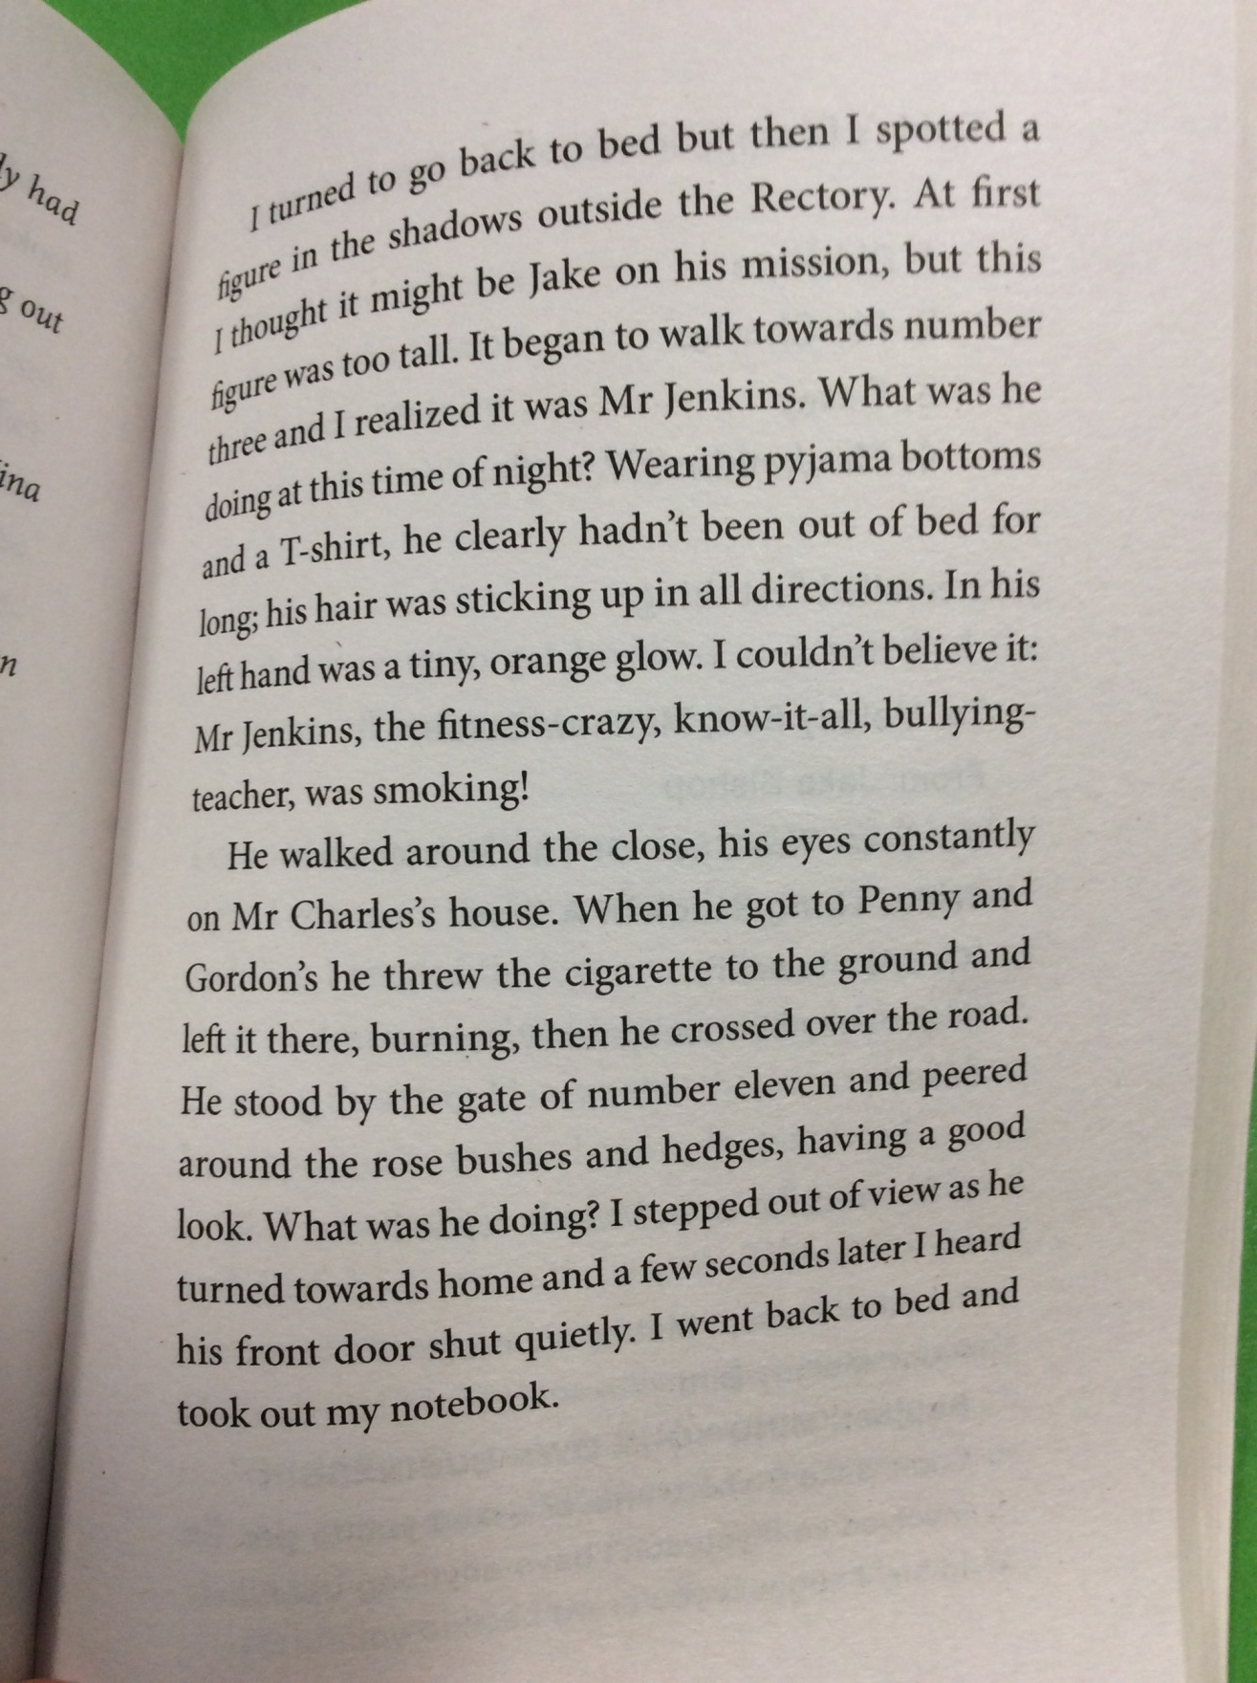

Slide 8
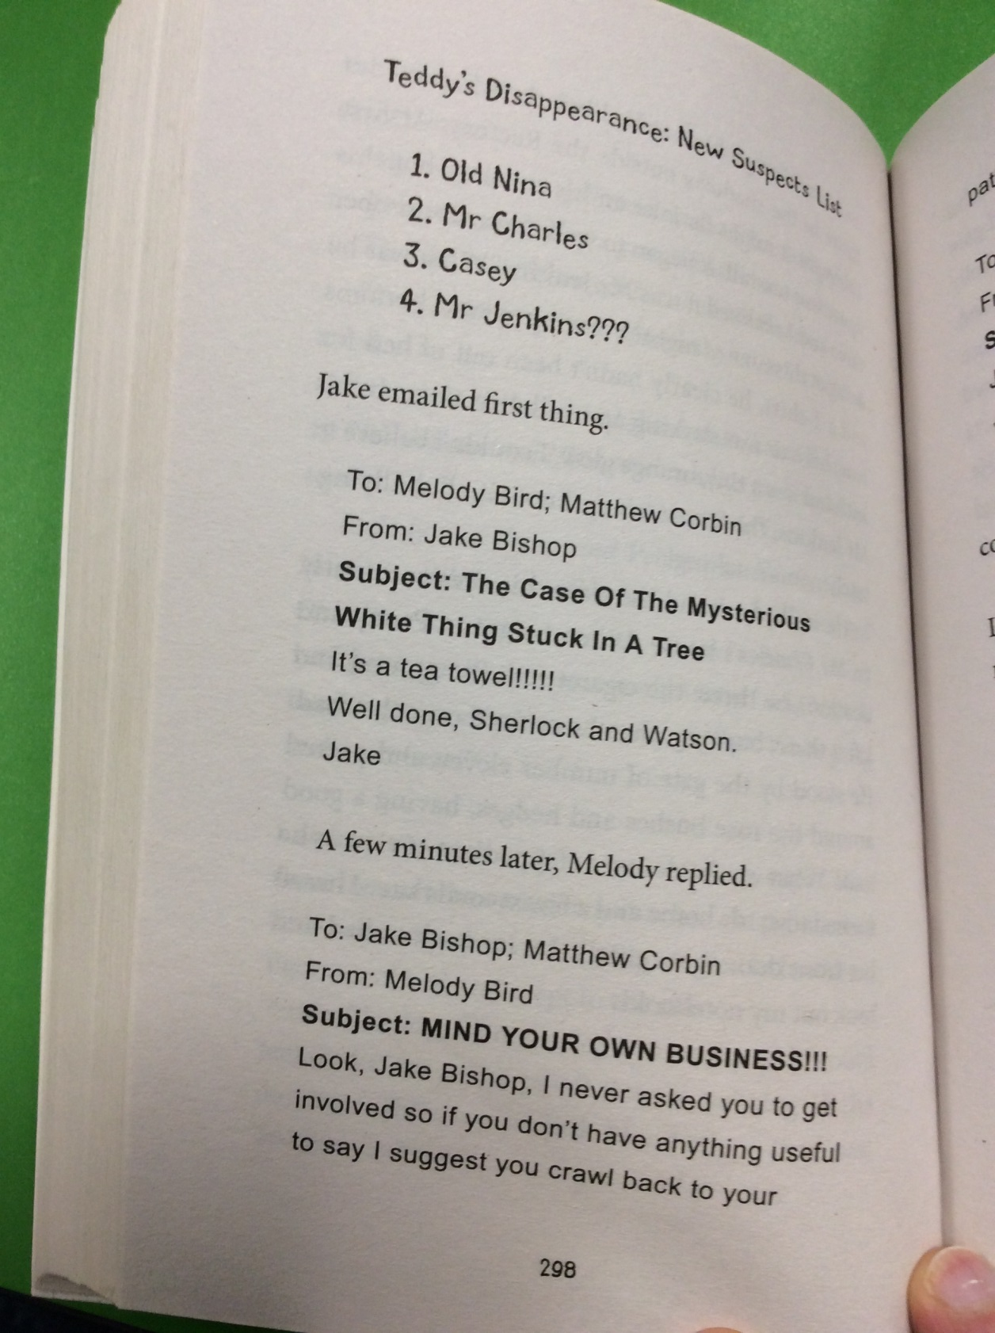

Slide 9
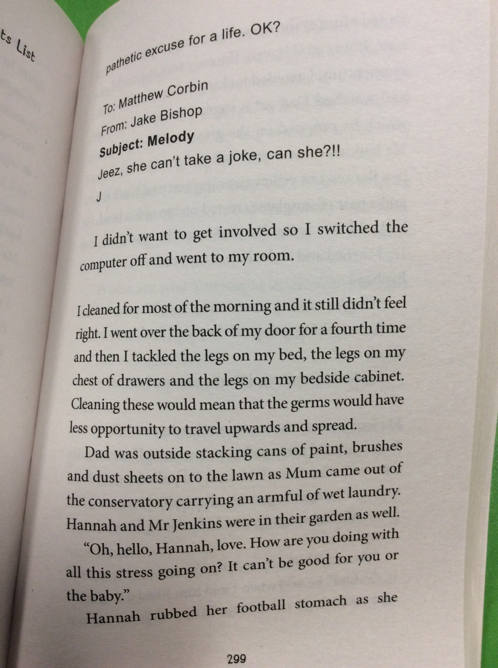

Slide 10
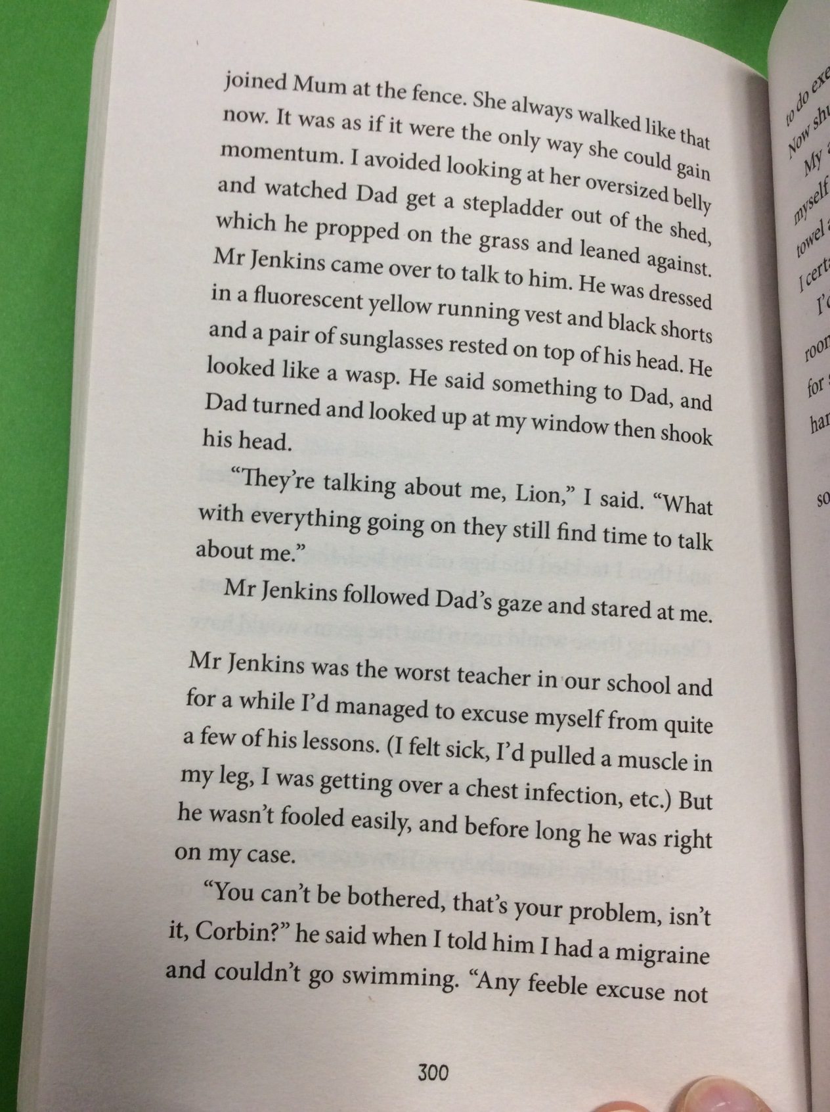

Slide 11
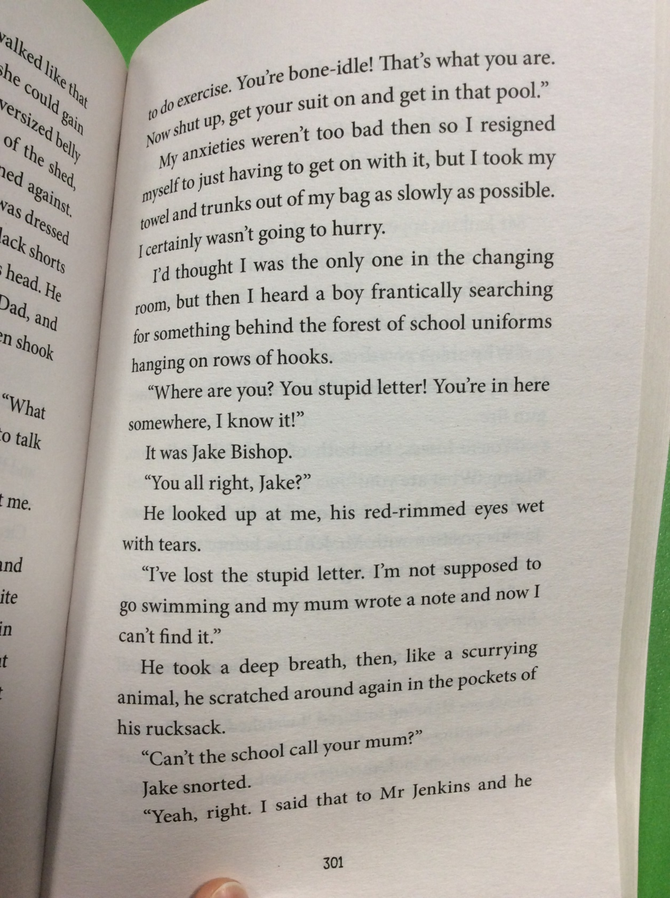

Slide 12
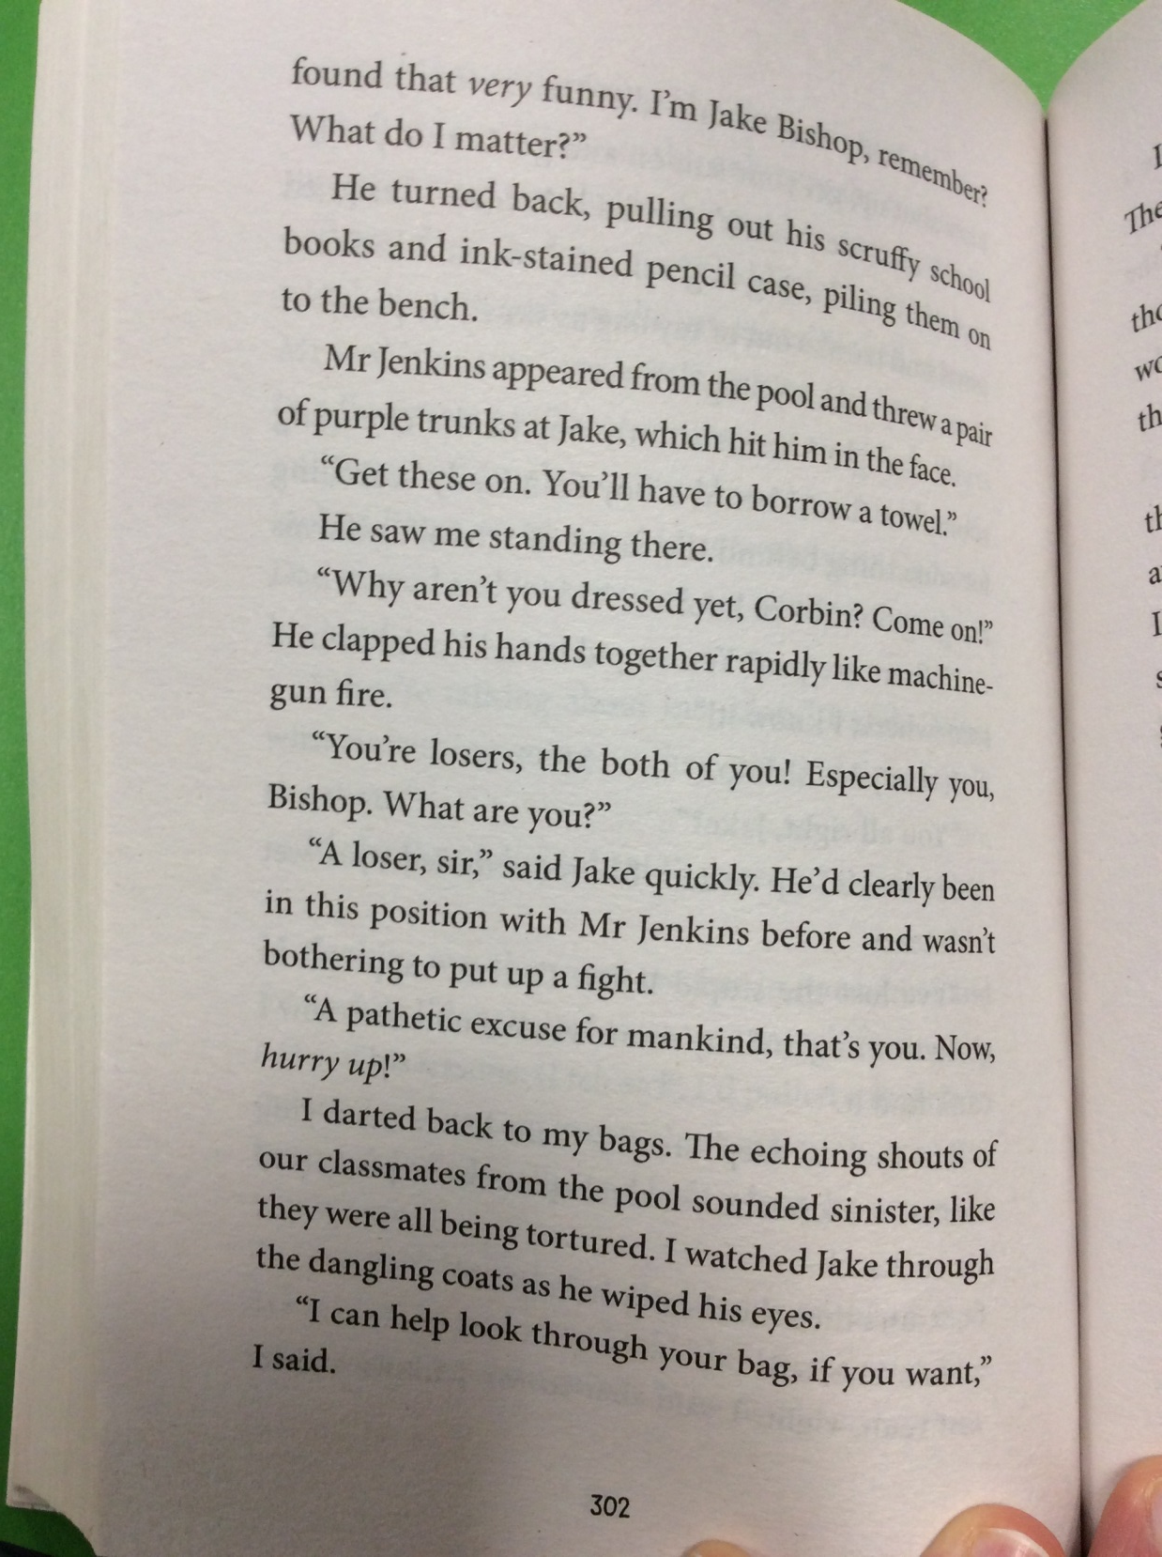

Slide 13
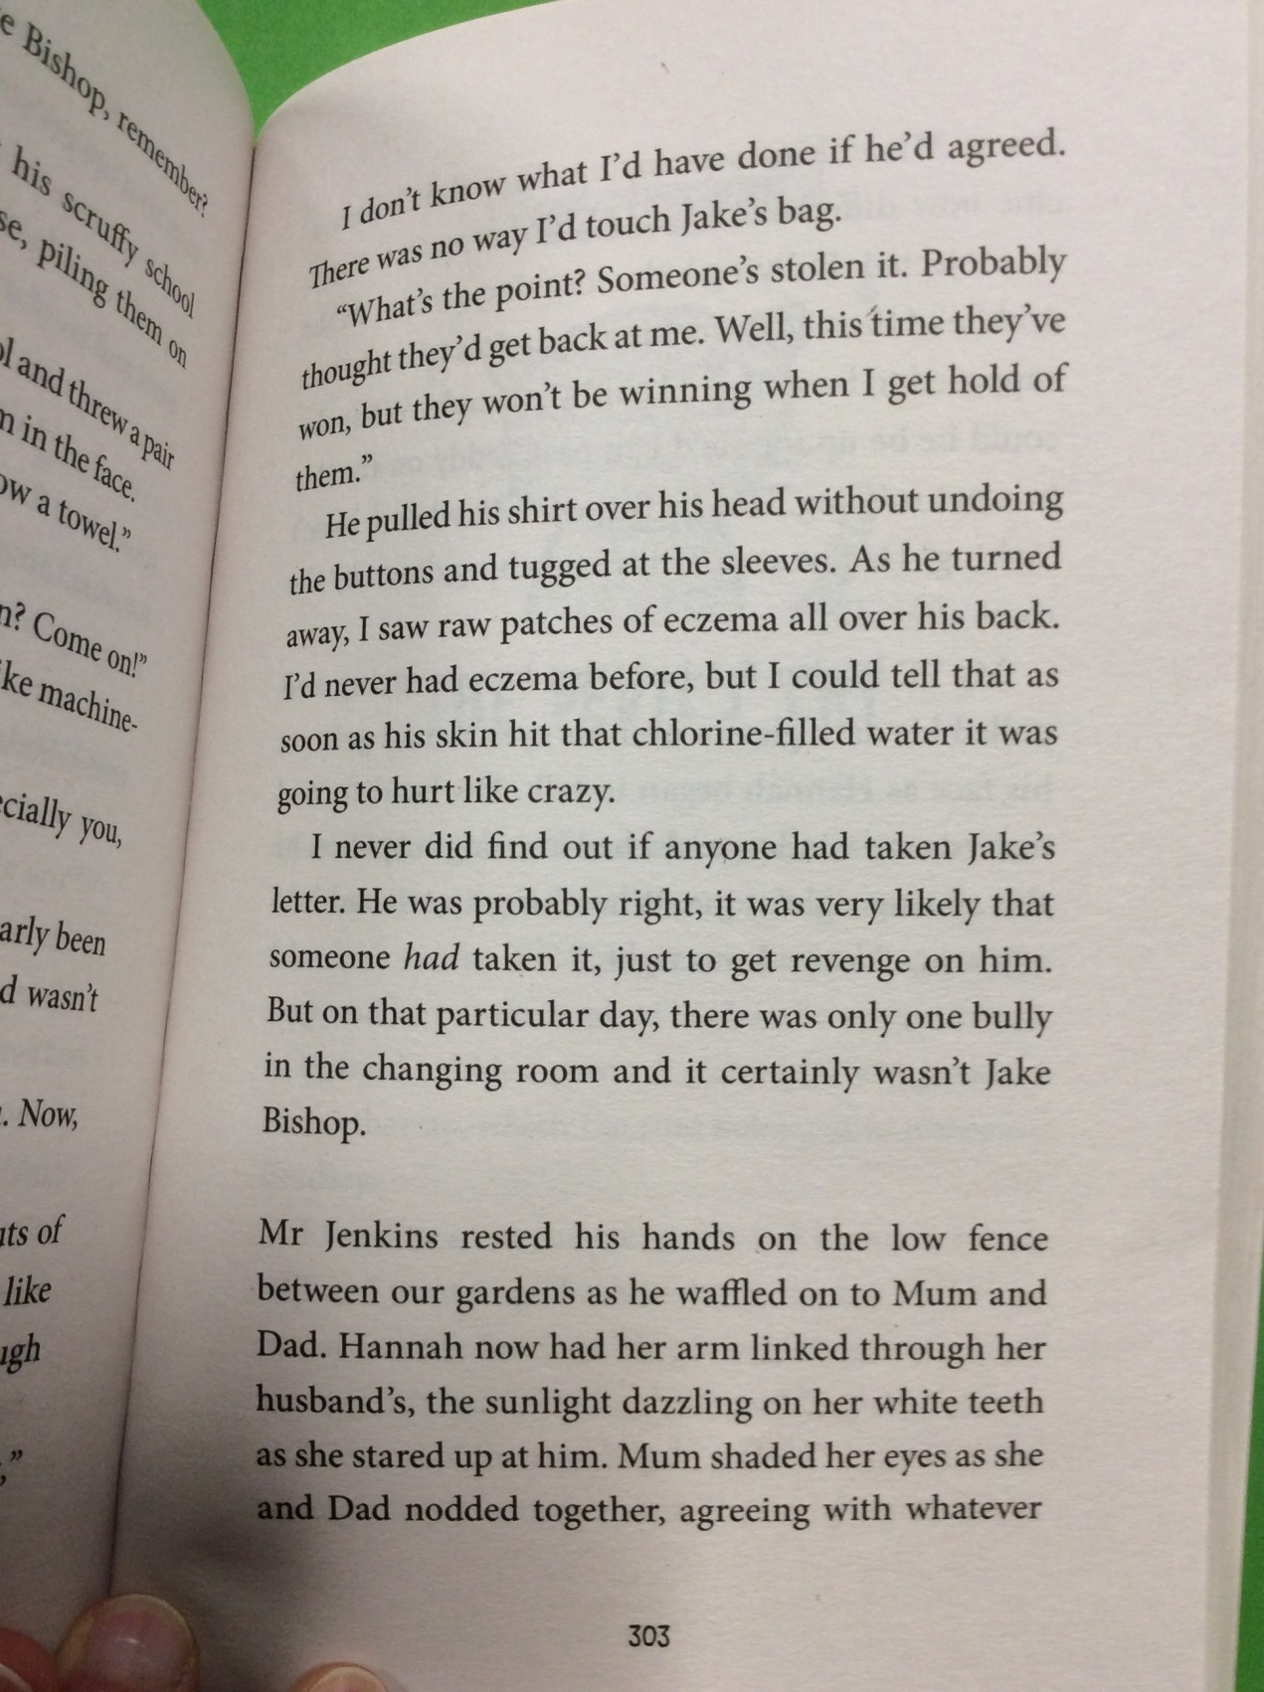

Slide 14
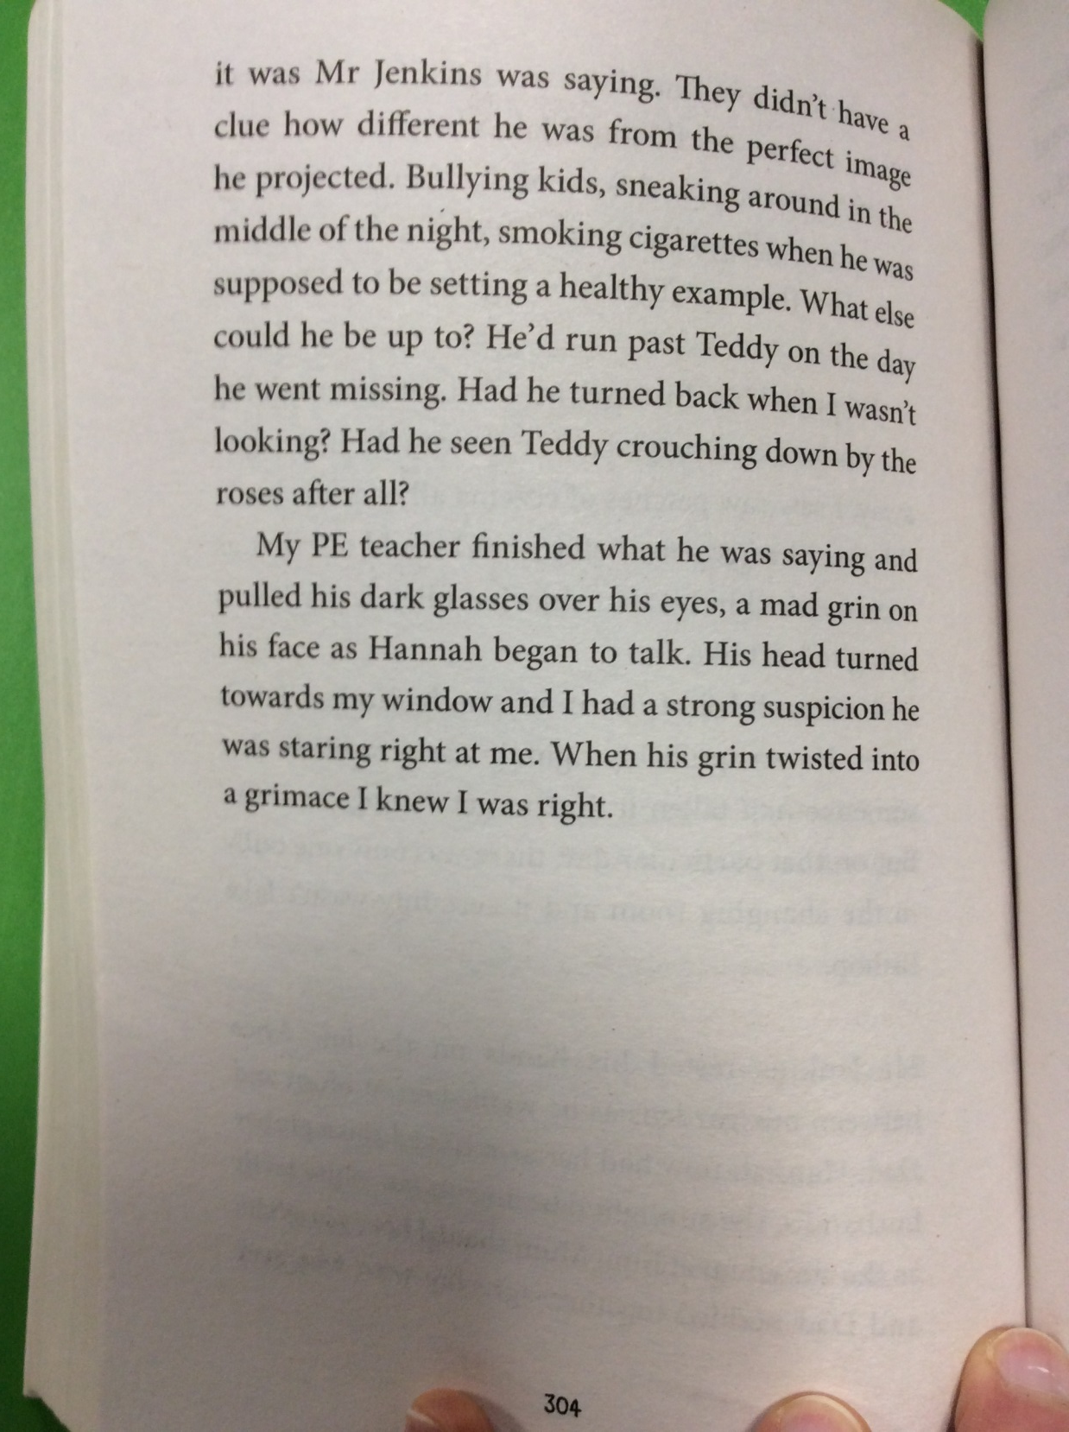

Slide 15
What are your thoughts on Mr Jenkins now?

