Slide 1
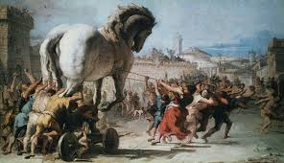
Heroes of Troy

Slide 2
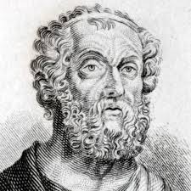
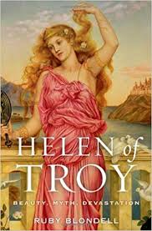
The Trojan War
The events of the Trojan War are written about in a number of works of Ancient Greek texts, including Homer’s epic poem The Iliad, which is at least 2,500 years old.
The cause of the war is Helen’s running away from the Spartan court with Paris, a Trojan prince.
Helen is the wife of Menelaus - King of Sparta - and he gathers an army led by his brother, Agamemnon, to sail to Troy to take Helen back.

Slide 3
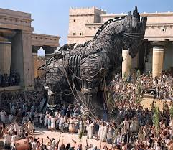
The Trojan War
The war lasts for 10 long years, during which time the main events are concerned with the clashes between the leading characters, climaxing with the death of Hector at the hands of Achilles (as written about by Homer in The Iliad) and continuing with the creation of the Trojan horse by Odysseus, the means by which Troy is finally vanquished and Helen returned to Menelaus.

Slide 4
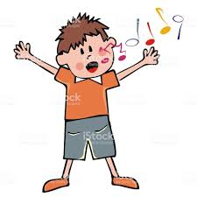
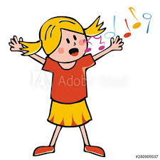
Heroes of Troy
We are going to learn some songs, which tell the story of the Trojan war – Heroes of Troy.
Some of the songs are split into two parts in places. Where this happens, just pick the part you want to sing.

Slide 5
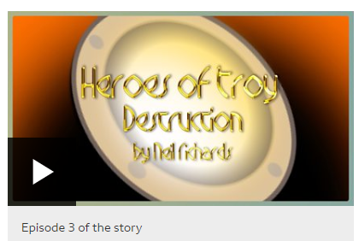
The Story
We need to get to know the story, so go to: https://www.bbc.co.uk/teach/school-radio/music-ks2-heroes-of-troy-video-clips/zr7xxyc and watch Episode 3 of the story.
It looks like this on the page:

Slide 6
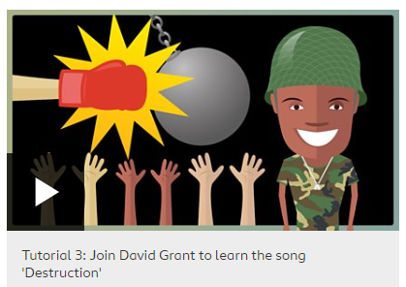
Destruction
Now it’s time to learn the third song. See if you can get some other family members to join in – singing is fun and they might enjoy it too.
Go to: https://www.bbc.co.uk/teach/school-radio/music-ks2-heroes-of-troy-video-clips/zr7xxyc
and play Tutorial 3.
It looks like this:

Slide 7
Destruction
It’s another catchy one isn’t it? Another rap too!
Next week, we will learn the next song.
If you can play an instrument, why not try to work it out on that?
Feel free to send me a video of you
singing or playing it.

