Slide 1
The Digestive system
By Livi and Emma

Slide 2
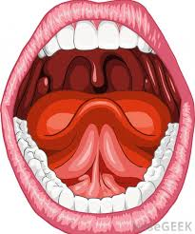
The Mouth
The mouth is the first part of the digestive
system, where food enters the body. The teeth chew the food into small pieces that can be swallowed.

Slide 3
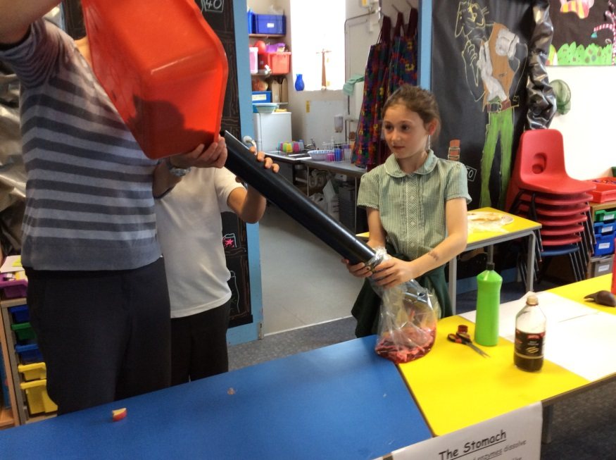
The Oesophagus
The Oesophagus squeezes the food down into the stomach.

Slide 4
The stomach
The stomach has acid and it squeezes and contracts so the food can be dissolved and broken down into a mush. The mush then goes into the small intestine.

Slide 5
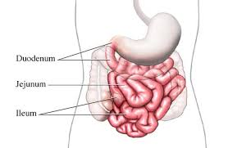
The Small Intestine
The small intestine has villi which sucks up the nutrients from the food. It also has bile which it digests the fatty food. And then it goes into the large intestine.

Slide 6
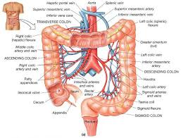
The Large Intestine
The large intestine is thicker than the small intestine and it absorbs all the water that is in the food. What is then left is waste which the body needs to get rid of.

Slide 7
The Rectum
The rectum is where all the waste is held until it leaves the body. Waste, also called poop, is made up of dead cells, bacteria and fibre.
The anus is the muscle which holds the poo in the rectum. When you poo, the anus relaxes so it can come out!

Slide 8
The End

