Slide 1
Science – Inherited characteristics - recap
Evolution watch – Last week we looked at inherited characteristics. Watch this clip for a recap!
https://www.bbc.co.uk/programmes/p02mtd91

Slide 2
Here is some important information for you to remember from our last session:
Some features are inherited from parents to offspring.
Offspring are not identical to their parents
When parents produce offspring, characteristics are mixed randomly to form offspring with features of both parents– like our plants!

Slide 3
Here are some cross breeds of dog. They have inherited characteristics from both parents.
This is artificial selective breeding!
Breeders put 2 parents together in the hope that they will produce offspring that will look a certain way or behave a certain way.

Slide 4
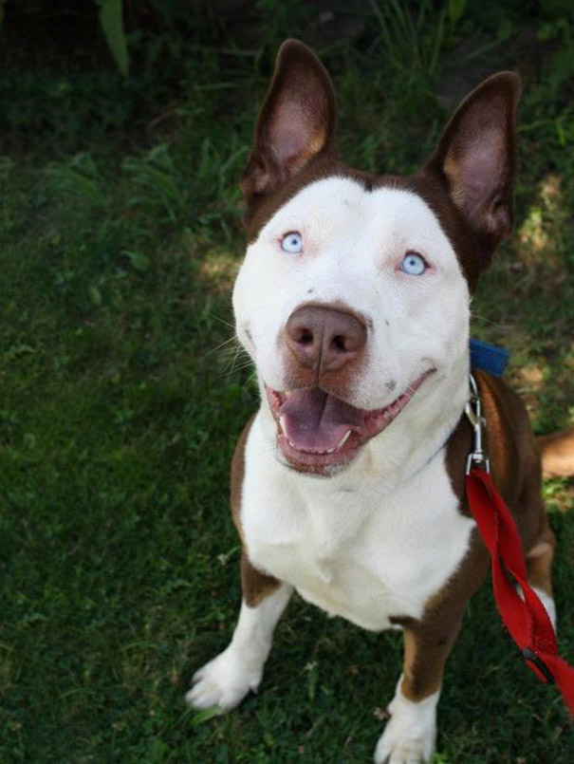
Pitsky: Pitbull & Husky Mixed Breed Dog

Slide 5
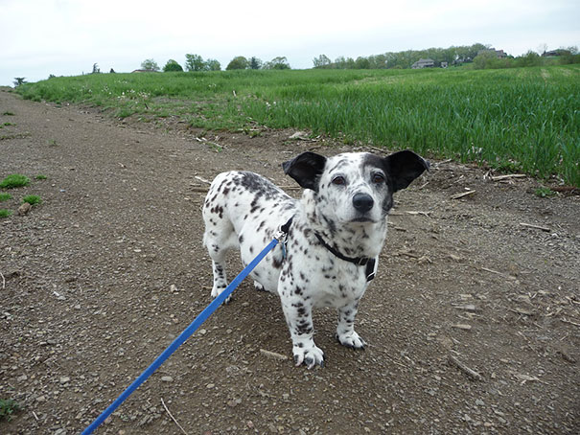
Cormation: Corgi and Dalmatian Mix

Slide 6
Dalmachshund: Dachshund & Dalmatian Mutt

Slide 7
Labsky: Labrador & Husky Mutt

Slide 8
Chug: Pug & Chihuahua Mixed Breed Dog

Slide 9
Yoodle: Yorkshire Terrier & Poodle Mutt

Slide 10
Cocker-Pei: Shar-pei & Cocker Spaniel Mutt

Slide 11
Bullman: English Bulldog & German Shepherd Cross

Slide 12
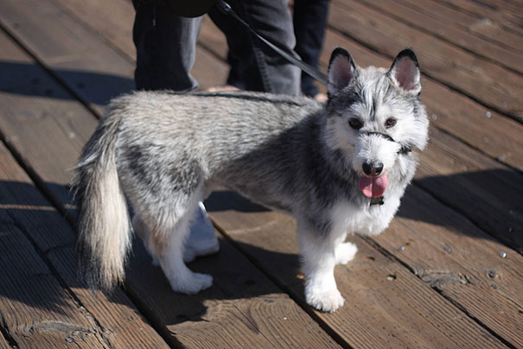
Horgi: Corgi & Husky Mix

Slide 13
Goberian: Siberian Husky & Golden Retriever Crossbreed

Slide 14
A game to play from the Science Museum – Thingdom This is a game that you can keep playing!
If you google Thingdom, you can access a simulation.
Read the information about inherited characteristics before you play.
Play the game – you will be asked to nurture your own Thing. Then you will be given instructions about the offspring that you need to produce. You will have to choose another Thing to reproduce with to create the inherited characteristics.
Use these links to access it.
http://whoami.sciencemuseum.org.uk/whoami/thingdom
https://preloaded.com/work/science-museum-thingdom/
https://www.gamesindustry.biz/articles/thingdom-a-genetics---brain-science-game-aimed-at-11---16-year-olds
I hope you can access this
For the first 2 links you will need flash player.

Slide 15
Mutations and Adaptions How and why some animals have evolved to be better camouflaged? Watch this:
https://www.bbc.co.uk/programmes/p02mtcs3

Slide 16
Tasks
Recreate the pinky and greeny investigation and test it out on your family! Pretend that you are a wildlife expert and use words like mutation, evolved. Film yourself doing it! You don’t need to use sweets. You could use anything that will be camouflaged amongst leaves that you find in the garden.
Or
Make a detailed labelled sketch of a creature that has adapted to its environment using camouflage. Explain how it is camouflaged and how it blend into its habitat.

Slide 17
Finally, here is a book that I was going to read to you about how a moth has mutated and adapted to its habitat using camouflage.
I photographed each page and the important science information at the back of the book. Read it with your family, on your own, get someone to read it to you.
When you have finished discuss how the moth adapted according to its habitat.

