Slide 1
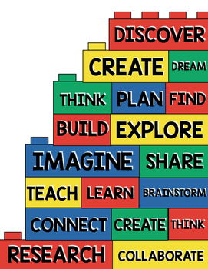
Maths
Fractions
The four operations
Rounding
Negative numbers
Perimeter, area and Volume
Decimals
Percentages
Ratio
Algebra
English
We will be reading Goldfish Boy by Lisa Thompson. We will investigate the characters and make detailed character descriptions from the perspective of different voices within the book.
We will also be using the books “Rise Up” and Goodnight Stories for Rebel Girls” as models for our own biographical writing about famous scientists, engineers and mathematicians.
We will revise the different word classes and learn the year 6 grammar and spelling.
PSHE
Living in the wider world.
Rights and responsibilities.
Science
Animals including Humans
We will find out about:
The circulatory system – the heart, blood vessels and blood.
Recognise the impact of diet, exercise, drugs and lifestyle on the way our bodies function.
How nutrients are transported through our body.
A visit from a
Maths Magician
Music
Relating musical notes to fractions.
Investigating, composing and performing rhythm.
Composing music using Chrome Music Lab.
Our class book this term is “Goldfish Boy”. We will also be reading extracts from “Rise Up”.
Spanish
Likes and dislikes
RE Hinduism
Understand who and where the Hindu faith was founded.
Explain the main beliefs in Hinduism.
Special places to Hindus.
Special Hindu festivals
Holy book
Symbols and meanings
P.E
Cycling – learning about the importance of bike maintenance and safety aspects, control when travelling at different speeds – on and off the bike, using the bike track safely and taking part in a variety of games using your bike
Gym
Games – Football
DT Cogs and Gears
Learn how to build a gear box and recognise how the different cogs work.
Discover the effects of having a 3rd axle and record how many turns of a handle it takes for 1 revolution of 3rd axle.
Discover how to use the electric motor to power the gearbox and investigate the maximum weight that can be lifted.
Relate this use of gears to real life. Where can gear boxes be found. Design your own bike and explain where the gears can be found and how they work to make the bike most efficient.
Art
Maths in art – Technical Drawing
We will investigate how artists and architects use 2d shapes within their designs.
We will learn to draw accurate 2d shapes using protractors and compasses.
We will use these 2d shapes to make infinite patterns by accurate measuring and drawing.
We will attempt to construct sculptures in the same design using sticks and accurate measuring and cutting.

